Slide 1
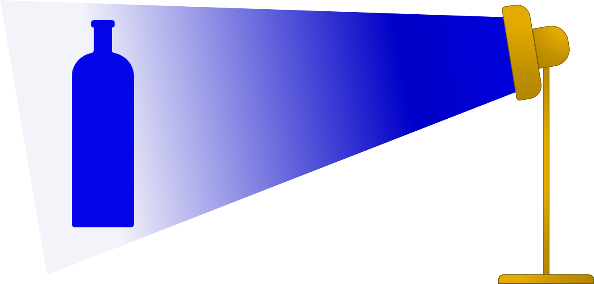
Blue bottle
A bottle looks blue in blue light and it looks blue in white light.
Why does the bottle look blue in both kinds of light?

Slide 2
Blue bottle
Fill in the gaps to explain why the bottle looks blue.
You should only use the words reflects and absorbs.
In blue light
Blue light does not contain any other colour, just blue. When it lights up the bottle, the bottle __________ blue light. We see the light that the bottle __________.
In white light
White light contains all the colours of the spectrum. When the bottle is in white light it __________ blue light. The bottle __________ red light and green light. It __________ all of the colours in white light except for blue.
We see the bottle because of the light that it __________.
reflects
reflects
reflects
absorbs
absorbs
reflects

